Slide 1
GPA: Measure of Performance or Bargaining Tool?
A Micro-level analysis of National Grade Inflation at UCSD
By: Lucas Hsu, Diego Saldonid, James Mata, Roger Ruan

Slide 2
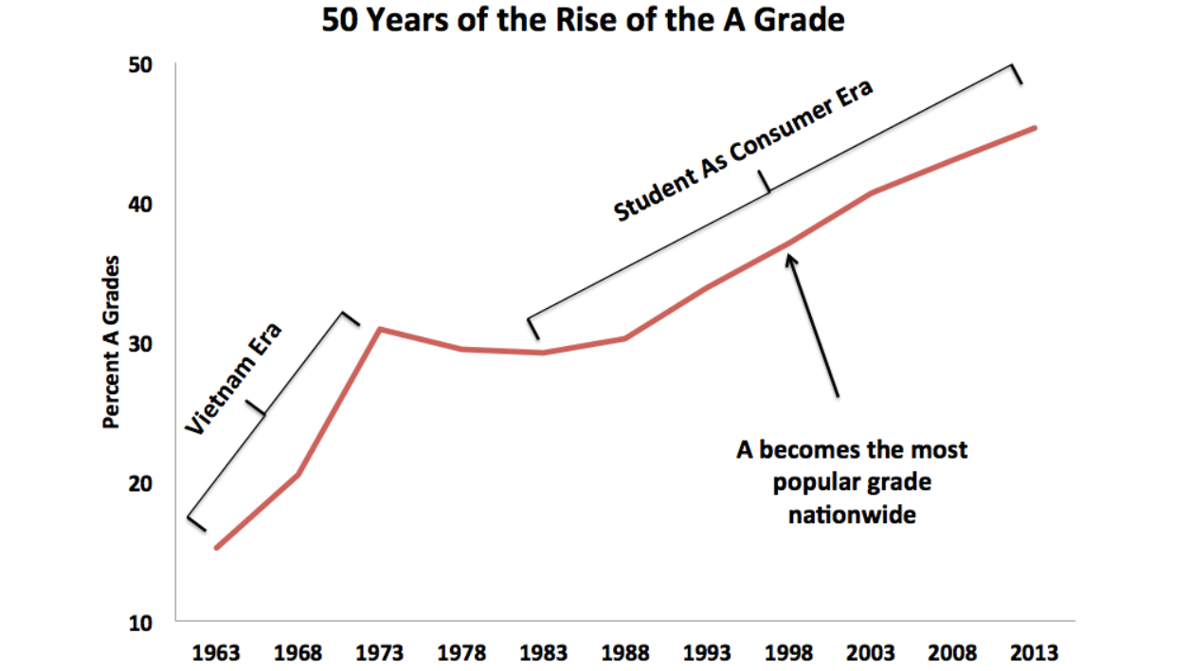
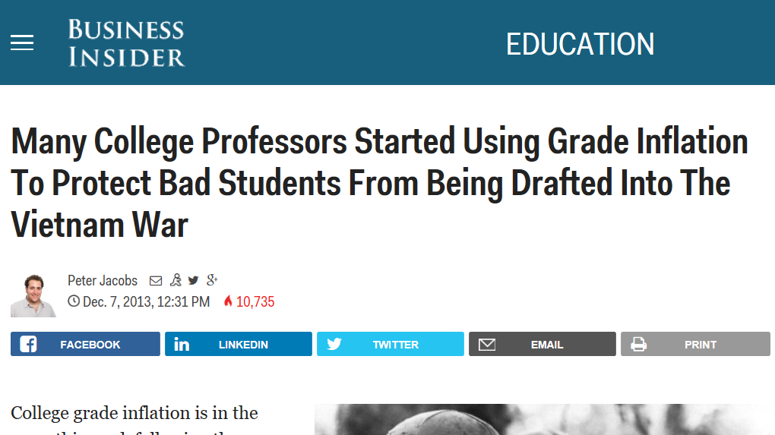
Why GPA?
“Grades will almost always rise in an academic environment where professors sense that there are incentives to please students” - Stuart Rojstaczer & Christopher Healy (Researchers on Grade Inflation)
Notes:
better student based evaluation

Slide 3
What does this mean ?
GPA can highlight student accomplishments to recruiters
GPA can reflect students’ performance in academic environment
Is this(GPA inflation) unfair for some students/professors ?
Can this affect student-professor relationship ? Is it going to be genuine anymore ?
Notes:
*at the end*, we decide to dive deeper

Slide 4
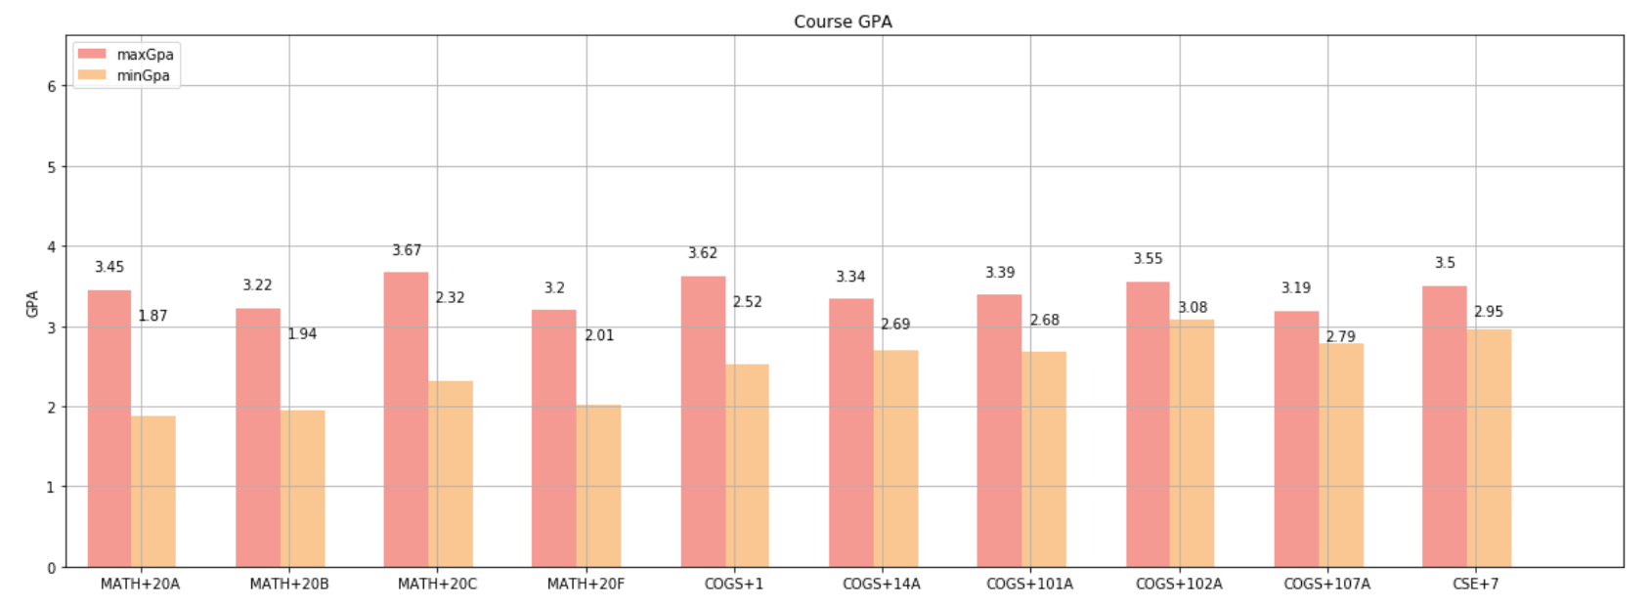
What is the difference ?
Scraped data from UCSD CAPE(Course And Professor Evaluations)
Classes like MATH20A have professors that grade significantly harsher than others
The highest GPA average is 3.45 (A- is 3.7, B+ is 3.3)
The lowest GPA average is 1.87( C is 2.0)

Slide 5
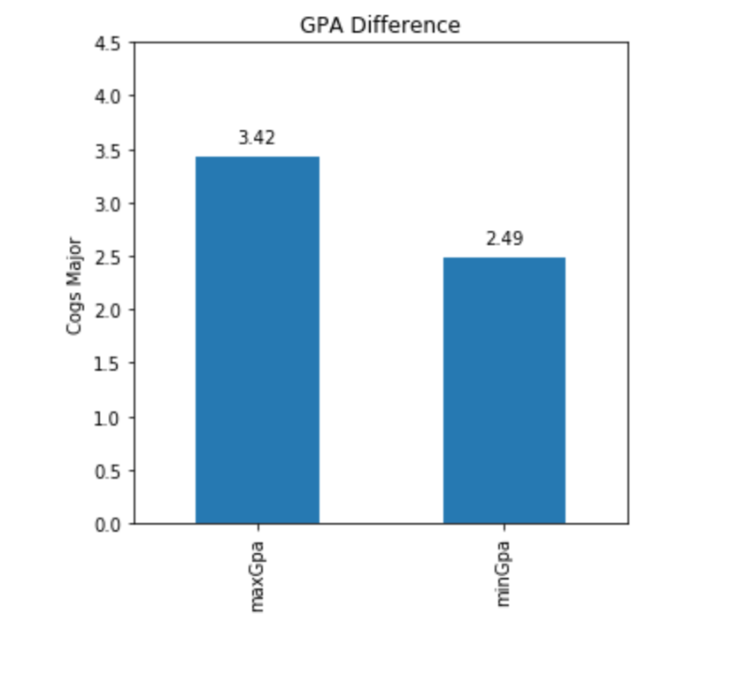
What is the difference ?
Students that took every class with highest average GPA vs Students that took every class with lowest average GPA
Both students did average in their respective classes
There is a nearly 1.0 GPA difference in a 4.0 scale. This is a whole letter grade different.
Notes:
In the graph below represents a student who did average in every class where the class average was the highest compared to a student who did average in every class where the class average was the lowest. Both students did average in their respective classes but one student has nearly 1.0 higher overall GPA, a whole letter grade higher, than the other, from averaging in the higher scoring class. This shows that the professors chosen during course selection affected their GPA.

Slide 6
So, what is happening…?
Is it possible that classes with lower average GPA just have students that do not study as hard ?
What are some possible factors that cause such a huge difference in GPA distribution?
Is it instructors ?
Is it the class material itself ?

Slide 7
Methods
Hypothesis testing : 2 sample t-test (average GPA of classes with poor professor rating vs average GPA of classes with high professor rating)
Scatter Plot (show here): Serves as micro analysis
GPA vs Inst. Rate: Do students that get higher grades recommend professors?
Hrs vs. Inst Rate: Do students that have to study more rate professors poorly?
Hrs vs GPA: Amount of hrs studied as an indicator of difficulty? What’s that telling us?
Avg grade expect vs inst rate: Do students that expect higher grades recommend professors higher?
Linear regression to figure out relationship between different grading categories
Notes:
-having participation as higher grade percentage of class will lead to students studying less and recommending professors more
-

Slide 8
So, what is happening…?
Performed a 2 sample t-test (average GPA of classes with poor professor rating vs average GPA of classes with high professor rating)
Our null hypothesis is that the mean GPA in poorer rating professors' classes should be the same of the mean GPA in better rating professor's classes
Our alternative hypothesis is that mean GPA in better rating professor's classes is higher(larger) than the mean GPA in poorer rating professors' classes
Assuming that the significance value α is 0.05. From the t-test result above, we know the p-value is smaller than α. That is, we can reject our null hypothesis and conclude that better rating professors tend to have higher GPA in the class.

Slide 9
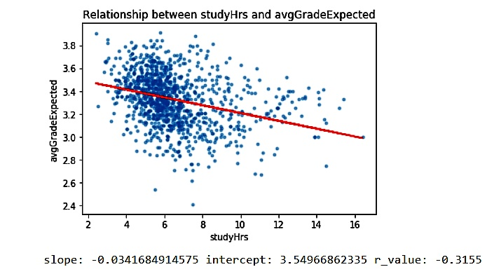
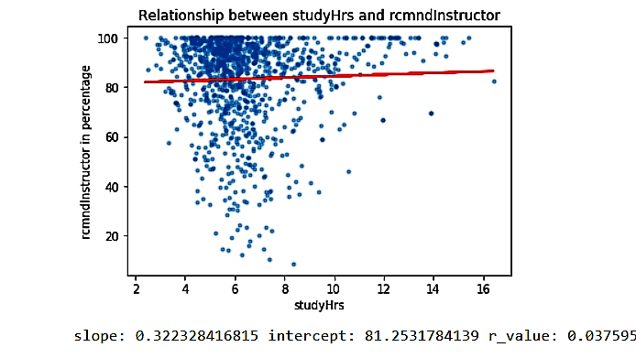
So, what is happening…?
Hmmm, do study hours not matter ?
Notes:
Furthermore, we find some interesting and counter intuitive results regarding study hours
*weak negative correlation*

Slide 10
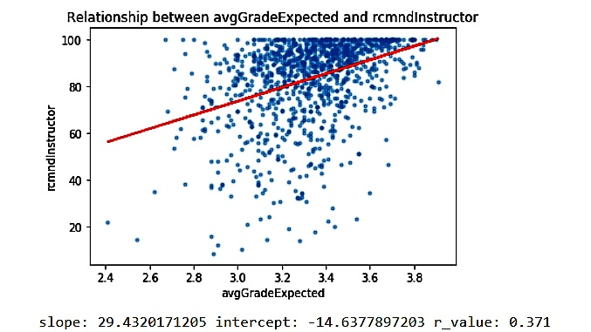
So, what is happening…?
It appears that students expected to get higher grade tend to give out higher recommended instructor rate.
Potential confounding variables
Extra Credit
Participation
Lowest Homework get dropped
Students not taking evaluations seriously

Slide 11
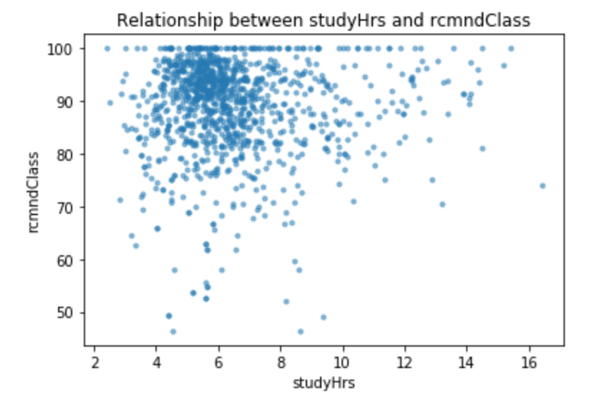
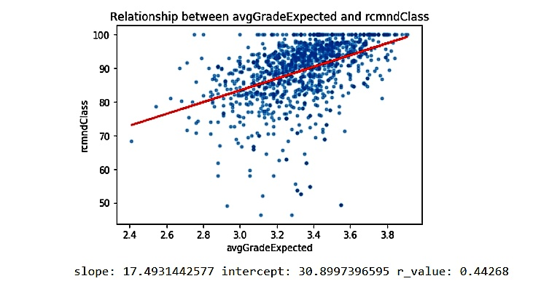
So, what is happening…?
It appears that students expected to get higher grade tend to give out higher recommended class rate.

Slide 12
So, what is happening…?
Seems like we are getting into this feedback loop that that students expected to get higher grade tend to give out higher recommended instructor/recommended class rate.
Instructors then have the incentive to please students to give better feedback
They do so by offering participation points, extra credit and similar stuff
So, WHAT CAN WE DO ?

Slide 13
Conclusion/Discussion
GPA is still the easiest and most popular way to evaluate a student
Call to action:
grading policy that is same across courses
Consequences:
May result in lower GPAs
Could provide actual relevant feedback for learning
Eliminate incentive of student picking professor just on grade distribution
Eliminate incentive of professors inflating grade just to get better rating from students
Create a more genuine and fair environment among students and faculty
Notes:
In conclusion, GPA is still the easiest and most popular way….. However, we see that GPA is biased right now due to grade inflation. To mitigate these biases, we propose that we should at least have the same grading policy across sections for a course (like math 20A, no longer have that 1.5 GPA difference, 0.3 is good).... This can create a transparent grading structure which promotes gen.....

